Slide 1

TREES
https://www.cs.usfca.edu/~galles/visualization/BST.html

Slide 2

Nature View of a Tree
leaves
branches
root

Slide 3

Computer Scientist’s View
root
leaves
branches

Slide 4
Parts of a Tree
nodes

Slide 5
Parts of a Tree
parent node

Slide 6
Parts of a Tree
parent node
child nodes

Slide 7
Parts of a Tree
parent node
child nodes

Slide 8
Parts of a Tree
leaf nodes
root node

Slide 9
Parts of a Tree
sub-tree

Slide 10
Parts of a Tree
sub-tree

Slide 11
Parts of a Tree
sub-tree

Slide 12
Depth of a node
nodes
Depth 0
Depth 1
Depth 2
Depth 3

Slide 13
Depth of a Tree
  Depth of a tree is the maximum depth of any of its leaves.
    Note: depth and height means one and the same thing
Full Binary Tree
  Every leaf has the same depth, and every non-leaf has two children

Slide 14
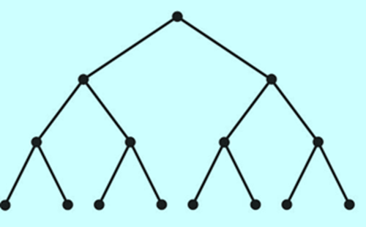
Implementation using pointers
Information for each node of a tree is stored in a struct
The strcut contains pointers linking it to others nodes in the tree
  For binary trees, we will link each node to its left and right child
struct TreeNode
{
int value;
TreeNode *left;
TreeNode *right;
}

Slide 15
Tree Applications

Slide 16
Applications of Binary Trees
Binary Search tree – BST
  For searching
Expression Tree
  For processing mathematical expressions

Slide 17
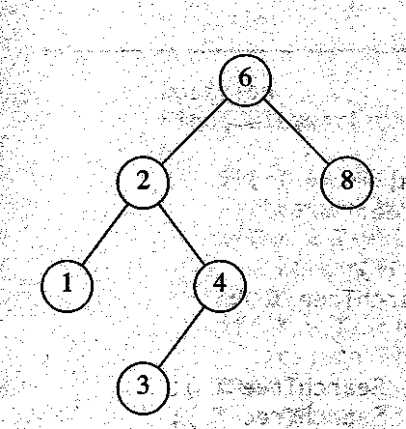
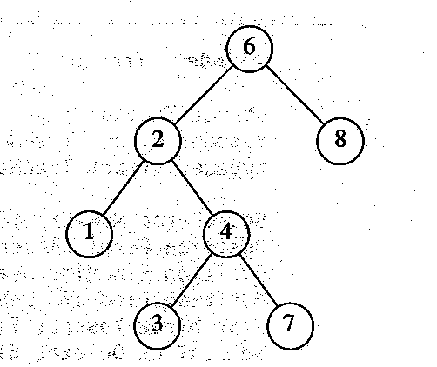
Binary Search Tree
For every node, X, in the tree,
  the values of all the keys in its left subtree are smaller than the key value of X, and
  the values of all the keys in its right subtree are larger than the key value of X.
X
√

Slide 18
Binary Search Tree Operations
There are many operations one can perform on a binary search tree.
a) Inserting a node into a binary search tree
b) Finding a node in a binary search tree
c) Deleting a node in a binary search tree.
We will use a simple class that implements a binary tree to store
integer values.
class IntBinaryTree
{
private:
struct TreeNode{
int value;
TreeNode *left;
TreeNode *right;
};
TreeNode *root;

Slide 19
root pointer
The root pointer is the pointer to the binary tree. This is similar to the head pointer in a linked list.
The root pointer will point to the first node in the tree, or to NULL (if the tree is empty).
It is initialized in the constructor.

Slide 20
class IntBinaryTree
{
private:
struct TreeNode{
int value;
TreeNode *left;
TreeNode *right;
};
TreeNode *root;
void tree_clear(TreeNode *&);
void deleteNode(int, TreeNode *&);
void makeDeletion(TreeNode *&);
void displayInOrder(TreeNode *);
public:
IntBinaryTree() // Constructor
{ root = NULL; }
~IntBinaryTree() // Destructor
{ tree_clear(root); }
void insertNode(int);
bool searchNode(int);
void remove(int);
void showNodesInOrder(void)
{ displayInOrder(root); }
};

Slide 21
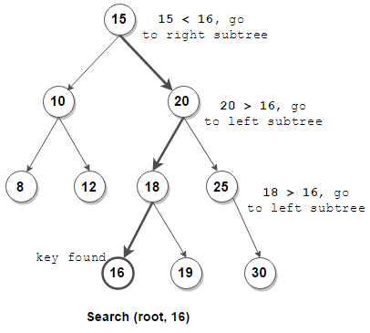
Searching for 16

Slide 22
Searching the Tree
The function starts at the root node, and traverses the tree, until it
finds the search value, or runs out of nodes.
bool IntBinaryTree::searchNode(int num)
{
TreeNode *nodePtr = root;
while (nodePtr)
{
if (nodePtr->value == num)
return true;
else if (num < nodePtr->value)
nodePtr = nodePtr->left;
else
nodePtr = nodePtr->right;
}
return false;
}

Slide 23
Program
#include <iostream.h>
#include "IntBinaryTree.h“
void main(void)
{
IntBinaryTree tree;
cout << "Inserting nodes.\n";
tree.insertNode(5);
tree.insertNode(8);
tree.insertNode(3);
tree.insertNode(12);
tree.insertNode(9);
if (tree.searchNode(3))
cout << "3 is found in the tree.\n";
else
cout << "3 was not found in the tree.\n";
}
Program Output
Inserting nodes.
3 is found in the tree.

Slide 24
Inserting a Node
The code to insert a new value in the tree is fairly straightforward.
First, a new node is allocated, and its value member is initialized
with the new value.

Slide 25
Note, we assume that our binary tree will store no duplicate values.
void IntBinaryTree::insertNode(int num)
{
TreeNode *newNode, // Pointer to a new node
*nodePtr; // Pointer to traverse the tree
// Create a new node
newNode = new TreeNode;
newNode->value = num;
newNode->left = newNode->right = NULL;
if (!root) // Is the tree empty?
root = newNode;
else
{
nodePtr = root;

Slide 26
while (nodePtr != NULL)
{ if (num < nodePtr->value)
{ if (nodePtr->left)
nodePtr = nodePtr->left;
else
{ nodePtr->left = newNode;
break;
}
}
else if (num > nodePtr->value)
{ if (nodePtr->right)
nodePtr = nodePtr->right;
else
{ nodePtr->right = newNode;
break;
}
}
else
{ cout << "Duplicate value found in tree.\n";
break;
}
}
}
}

Slide 27
Program
// This program builds a binary tree with 5 nodes.
#include <iostream.h>
#include "IntBinaryTree.h“
void main(void)
{
IntBinaryTree tree;
cout << "Inserting nodes. ";
tree.insertNode(5);
tree.insertNode(8);
tree.insertNode(3);
tree.insertNode(12);
tree.insertNode(9);
cout << "Done.\n";
}

Slide 28
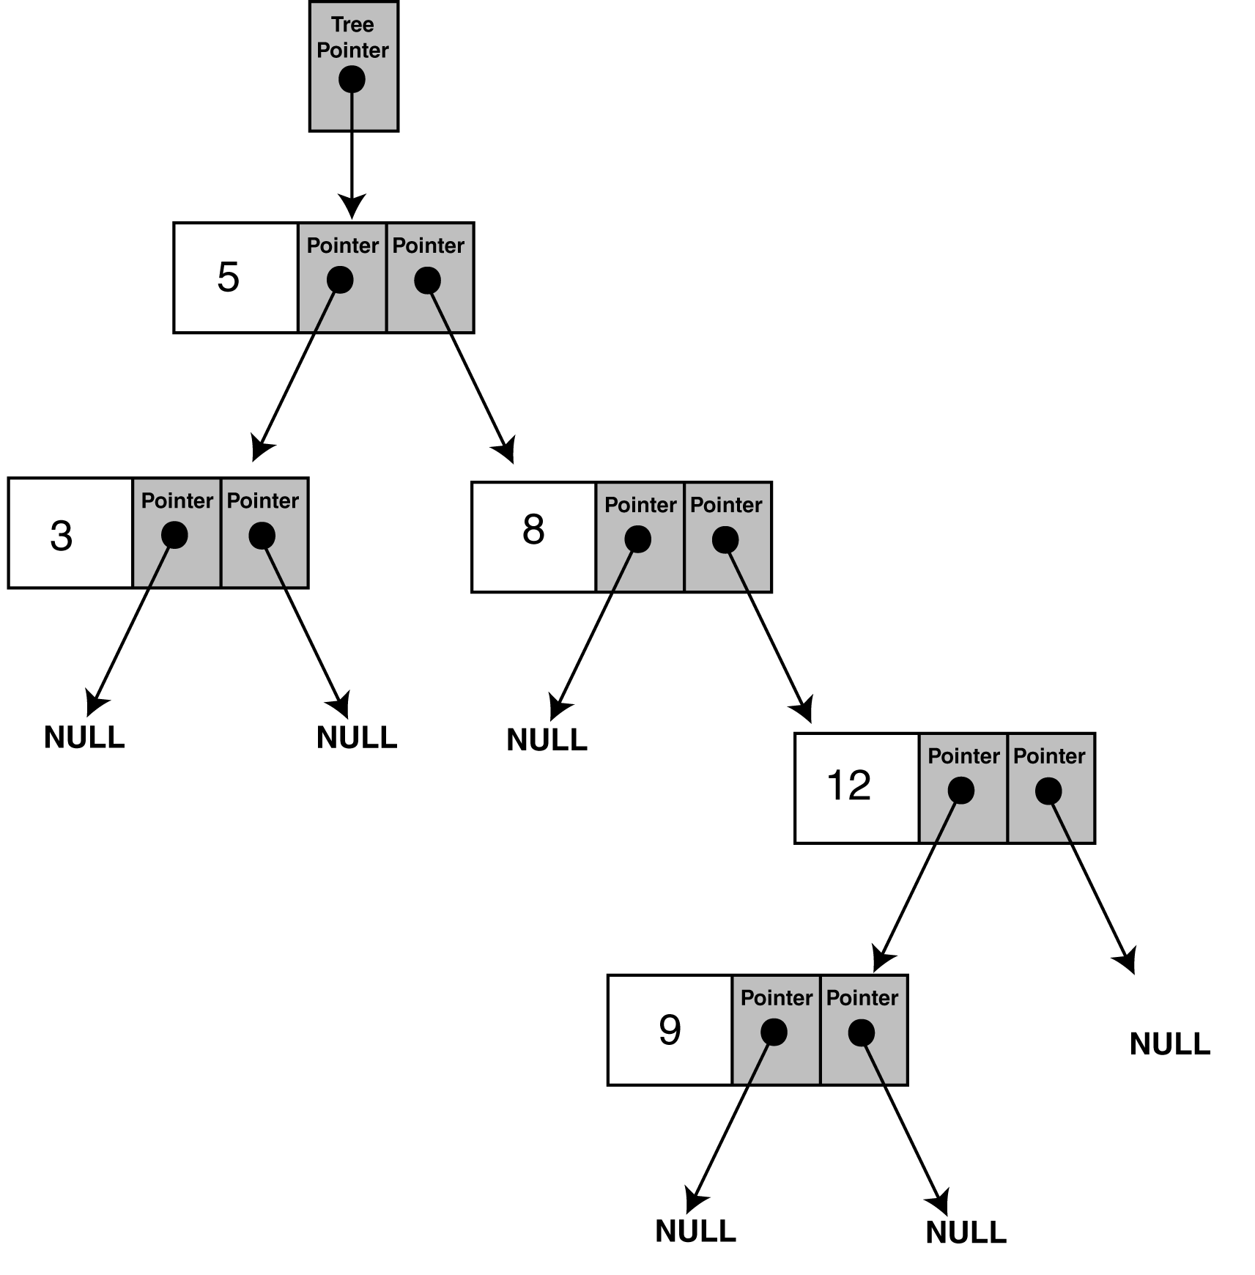
Program
Figure shows the structure of the binary tree built by the program.
Note: The shape of the tree is determined by the order in which the values are inserted. The root node in the diagram above holds the value 5 because that was the first value inserted.

Slide 29
The IntBinaryTree class can display all the values in the tree
The algorithms are initiated by the following inline public member
functions -
void showNodesInOrder(void)
{ displayInOrder(root); }
This public member functions calls a recursive private
member function, and passes the root pointer as argument.
The code for these recursive functions is simple -

Slide 30
void IntBinaryTree::displayInOrder(TreeNode *nodePtr)
{
if (nodePtr)
{
displayInOrder(nodePtr->left);
cout << nodePtr->value << endl;
displayInOrder(nodePtr->right);
}
}
}

Slide 31
Example: Inorder
43
31
64
20
40
56
89
28
33
47
59
20
28
31
33
40
43
47
56
59
64
89

Slide 32
Program
// This program builds a binary tree with 5 nodes.
// The nodes are displayed with inorder, preorder,
// and postorder algorithms.
#include <iostream.h>
#include "IntBinaryTree.h“
void main(void)
{
IntBinaryTree tree;
cout << "Inserting nodes.\n";
tree.insertNode(5);
tree.insertNode(8);
tree.insertNode(3);
tree.insertNode(12);
tree.insertNode(9);
cout << "Inorder traversal:\n";
tree.showNodesInOrder();
}

Slide 33
Program Output
Inserting nodes.
Inorder traversal:
3
5
8
9
12

Slide 34
Deleting a node
To delete a leaf node is easy -
  Find its parent
  Set the child pointer that links to it to NULL
  Free the node’s memory
To delete a parent node
  The node has one child.
  The node has two children

Slide 35
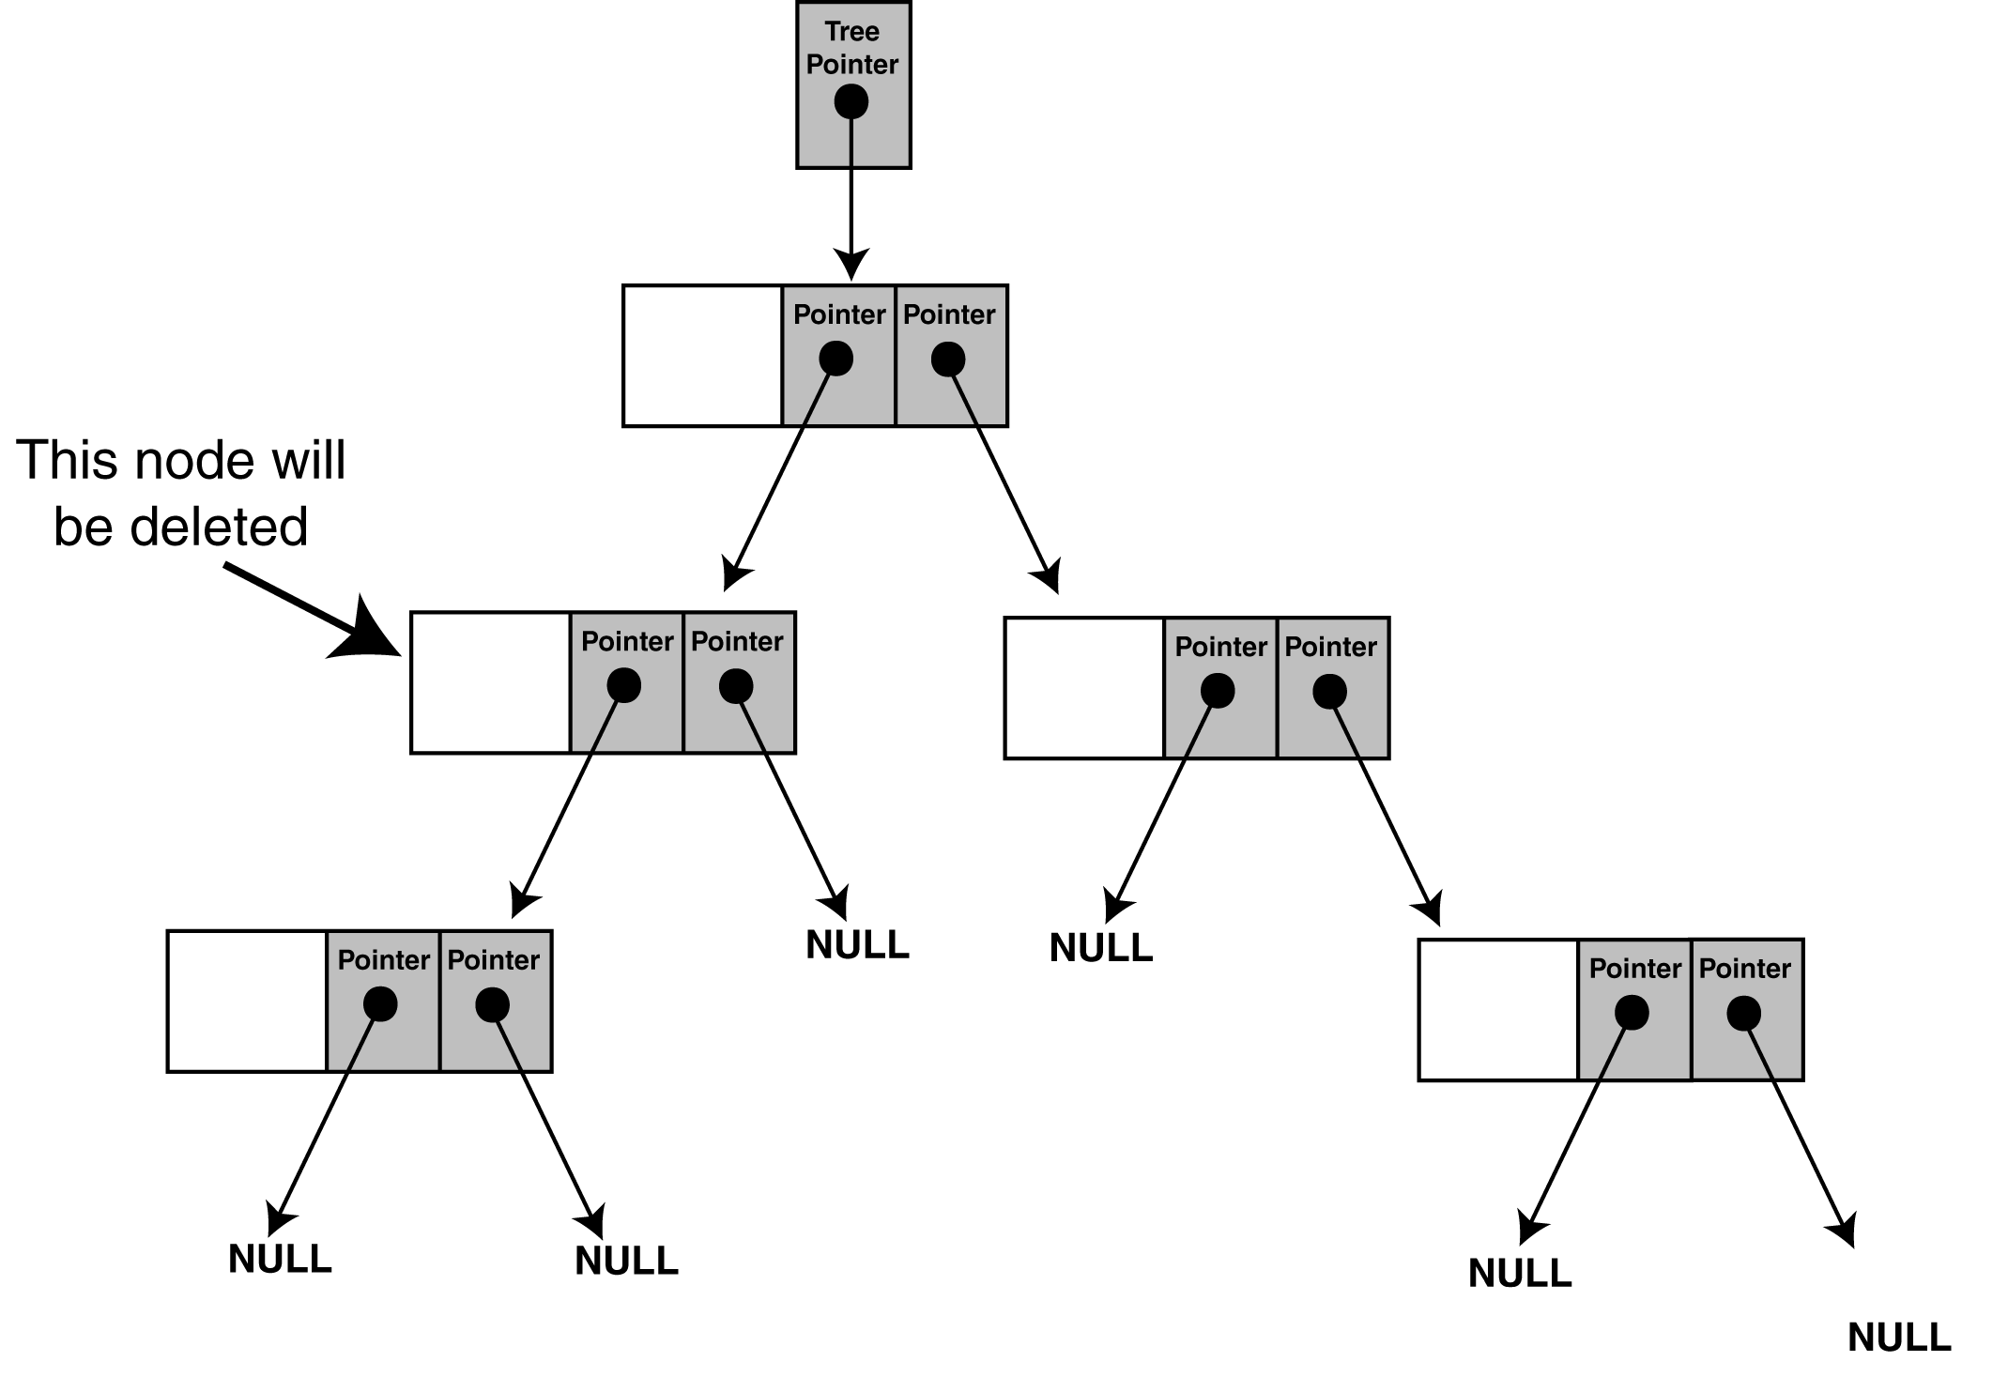
One child scenario

Slide 36
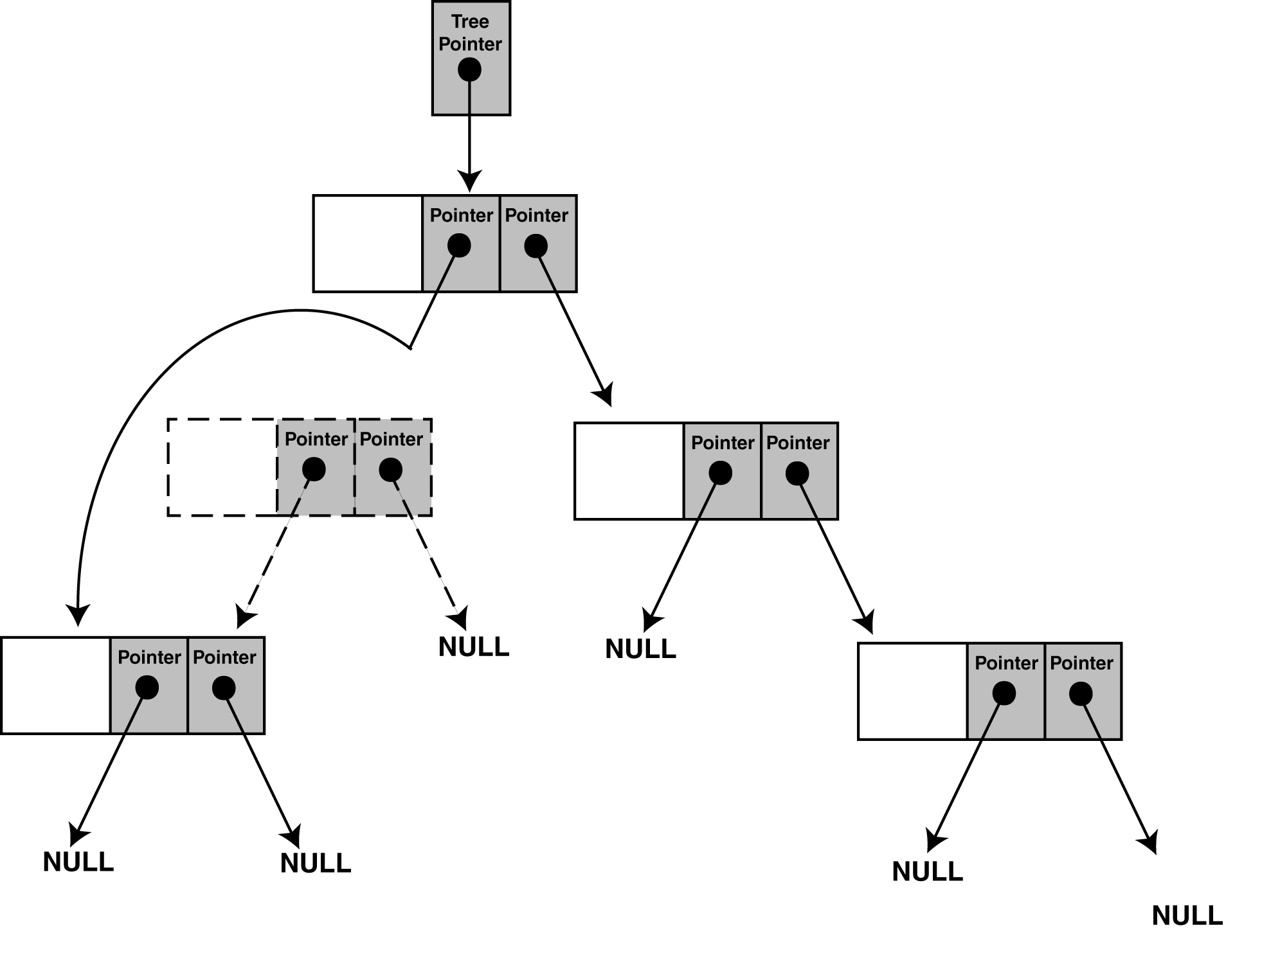
Solution

Slide 37
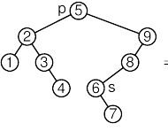
Example

Slide 38
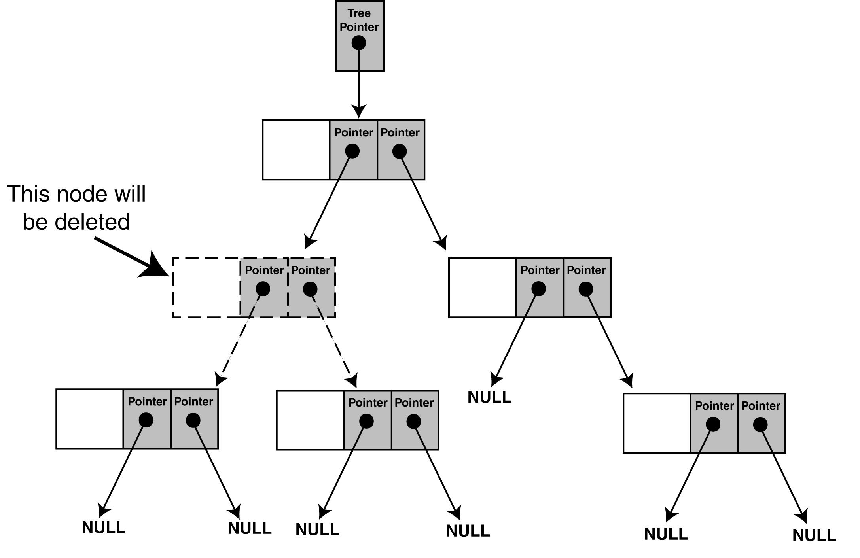
Two children scenario
We cannot attach both of the node’s subtrees to its parent.
One solution is to -
a) find a position in the right subtree to attach the left subtree.
b) attach the node’s right subtree to the parent

Slide 39
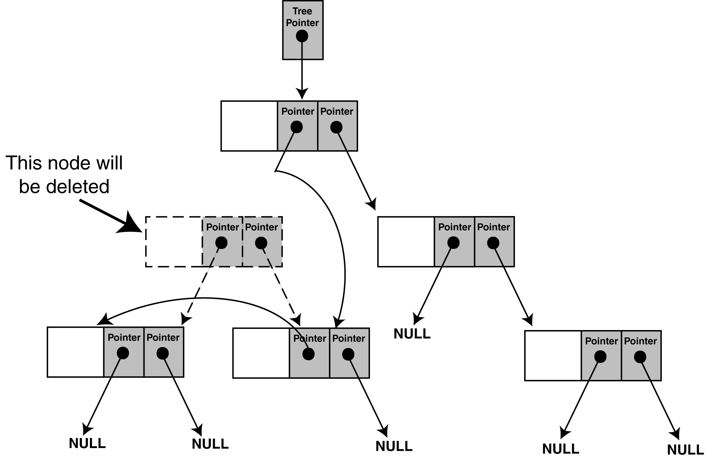
Now the code - to delete a node from the IntBinaryTree, call the
public member remove. The argument passed to the function is the
value of the node you want to delete.

Slide 40
void IntBinaryTree::remove(int num)
{
deleteNode(num, root);
}
The remove member function calls the deleteNode member
function. It passes the value of the node to delete, and the root
pointer.
The deleteNode member function is shown below -

Slide 41
void IntBinaryTree::deleteNode(int num, TreeNode *&nodePtr)
{
if (num < nodePtr->value)
deleteNode(num, nodePtr->left);
else if (num > nodePtr->value)
deleteNode(num, nodePtr->right);
else
makeDeletion(nodePtr);
}
Notice the declaration of the nodePtr parameter:
TreeNode *&nodePtr;
nodePtr is not simply a pointer to a TreeNode structure, but a reference to a pointer to a TreeNode structure. Any action performed on nodePtr is actually performed on the argument passed into nodePtr

Slide 42
It must have access to the actual pointer in the tree to the node that
is being deleted (not just a copy of the pointer).
This is why the nodePtr parameter in the deleteNode function is a
reference. It must pass to makeDeletion, the actual pointer, to the
node to be deleted.
void IntBinaryTree::makeDeletion(TreeNode *&nodePtr)
{
TreeNode *tempNodePtr; // Temporary pointer, used in
// reattaching the left subtree.
if (nodePtr == NULL)
cout << "Cannot delete empty node.\n";
else if (nodePtr->right == NULL)
{
tempNodePtr = nodePtr;
nodePtr = nodePtr->left; // Reattach the left child
delete tempNodePtr;
}

Slide 43
else if (nodePtr->left == NULL)
{
tempNodePtr = nodePtr;
nodePtr = nodePtr->right; // Reattach the right child
delete tempNodePtr;
}
// If the node has two children.
else
{
// Move one node the right.
tempNodePtr = nodePtr->right;
// Go to the end left node.
while (tempNodePtr->left)
tempNodePtr = tempNodePtr->left;
// Reattach the left subtree.
tempNodePtr->left = nodePtr->left;
tempNodePtr = nodePtr;
// Reattach the right subtree.
nodePtr = nodePtr->right;
delete tempNodePtr;
}
}

Slide 44
Program
// This program builds a binary tree with 5 nodes.
// The DeleteNode function is used to remove two
// of them.
#include <iostream.h>
#include "IntBinaryTree.h“
void main(void)
{
IntBinaryTree tree;
cout << "Inserting nodes.\n";
tree.insertNode(5);
tree.insertNode(8);
tree.insertNode(3);
tree.insertNode(12);
tree.insertNode(9);
cout << "Here are the values in the tree:\n";
tree.showNodesInOrder();

Slide 45
cout << "Deleting 8...\n";
tree.remove(8);
cout << "Deleting 12...\n";
tree.remove(12);
cout << "Now, here are the nodes:\n";
tree.showNodesInOrder();
}
Program Output
Inserting nodes.
Here are the values in the tree:
3
5
8
9
12
Deleting 8...
Deleting 12...
Now, here are the nodes:
3
5
9

Slide 46
Destructor
~IntBinaryTree() // Destructor
{tree_clear(root); }
void tree_clear(BinaryTreeNode* nodeptr)
{
if (nodeptr != NULL) {
tree_clear( nodeptr->left );
tree_clear( nodeptr->right );
delete nodeptr;
}
}

Slide 47
Advantages
With a balanced binary search tree, the number of levels are log2 of number of nodes in the tree. Therefore for
insertion
searching and
deletion
  The most we will ever have to look at is “depth of the tree”
O(log₂n)

Slide 48
Practice
Sum of all node values

